Slide 1
Micro-services & Server-less architecture
Dr. Noman Islam

Slide 2
Introduction
In the past, most software applications were big monoliths, running either as a single process or as a very small number of processes spread across just a handful of servers
These applications had slow release lifecycles and were updated relatively infrequently.
At the end of every release cycle, developers would package them and hand them over to the ops team, who then deployed, monitored and manually migrated them when the hardware they were running on failed.

Slide 3
Today, big monolithic applications are slowly being broken down into smaller, independently running components called microservices
Because they are decoupled from each other, they can be developed, deployed, updated and scaled individually.
This enables us to change each of them quickly and as often as necessary to keep up with today’s rapidly changing business requirements.

Slide 4
The real challenge
But, with bigger numbers of deployable components and increasingly larger datacenters, it becomes increasingly difficult to configure, manage and keep the whole system running properly.
It becomes much harder to figure out where to put each of those components if we want to achieve a high enough resource utilization and keep the hardware costs down.

Slide 5
Doing all this manually isn’t going to work. We need some kind of automation, including automatic scheduling, configuration, supervision and failure-handling.
This is where Kubernetes comes in.

Slide 6
Kubernetes
Kubernetes enables developers to deploy their applications themselves and as often as they want, without requiring any assistance from the system administrators.
Kubernetes also helps system administrators by constantly monitoring and automatically rescheduling those apps in the event of a hardware failure.
The focus for sysadmins shifts from supervising individual apps to mostly supervising and managing Kubernetes and the rest of the infrastructure.

Slide 7
Kubernetes abstracts away the hardware infrastructure and exposes your whole datacenter as a single enormous computational resource.
It allows you to deploy and run your software components without having to know about the actual servers underneath.

Slide 8
This makes Kubernetes the perfect platform for cloud providers, allowing them to offer developers a simple platform for deploying and running any type of application, while not requiring their own sysadmins to know anything about the thousands or even millions of apps running on their hardware.

Slide 9
Why Kubernetes
Let’s take a quick look at how the development and deployment of applications has changed in recent years.
This change is both a consequence of splitting big monolithic apps into smaller microservices, and brought on by the changes in the infrastructure that runs those apps

Slide 10
To deal with increasing loads on the system, you then either have to vertically scale the server by adding even more CPUs, memory and other server components (scale up), or scale the whole system horizontally, by running multiple servers, each running a separate instance of the application (scale out)
Scaling out, may require big changes in the application code and is not always possible
If any part of a monolithic application isn’t scalable, the whole application is unscalable, unless you can split the monolith up somehow.

Slide 11
Splitting apps into microservices
These and other problems have forced us to start splitting complex monolithic applications into smaller independently deployable components called microservices.
Each microservice runs as an independent process and communicates with other microservices through simple, well-defined interfaces (APIs).

Slide 12
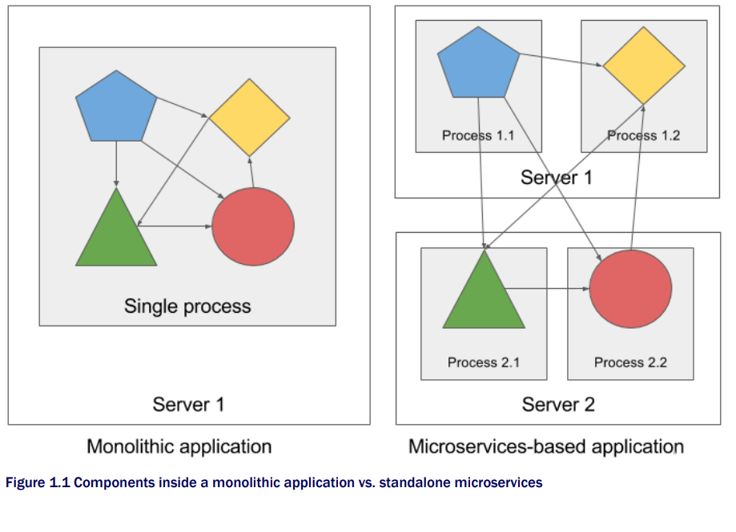

Slide 13
Since each microservice is a standalone process with a relatively static external API, it is possible to develop and deploy each microservice separately.
A change to one of them doesn’t require changes or re-deployment of any other service, provided that the API doesn’t change at all or changes only in a backwards-compatible way

Slide 14
Scaling microservices
Scaling microservices, unlike monolithic systems, where we need to scale the system as a whole, is done on a per-service basis, which means we have the option of scaling only those services that require more resources, while leaving others at their original scale
When a monolithic application can’t be scaled out because some of its parts are unscalable, splitting the app into microservices allows us to horizontally scale the parts that allow scaling out, and scale the parts that don’t, vertically instead of horizontally.

Slide 15
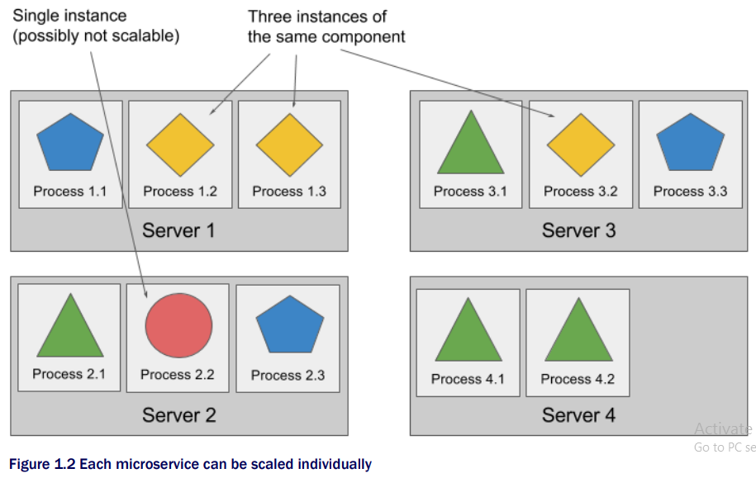

Slide 16
Deploying microservices
Of course, there are also drawbacks to microservices.
When your system consists of only a small number of deployable components, managing those components is easy.
It’s trivial to decide where to deploy each component, since there aren’t that many possibilities

Slide 17
When number of those components increases, deployment-related decisions become increasingly more difficult since not only does the number of deployment combinations increase, the number of inter-dependencies between the components increases as well.
Microservices perform their work together as a team, so they need to be able to find and talk to each other. When deploying them, someone or something needs to configure all of them properly in order to enable them to work together as a single system.

Slide 18
With increasing numbers of microservices, this becomes tedious and error-prone.
Deploying dynamically linked applications that require different versions of shared libraries, and/or require other varying kinds of environments, can quickly become a nightmare for the system administrators who are the ones deploying and managing them on production servers.

Slide 19
Continuous delivery and DevOps
In the past, the development team’s job was to create the application and then hand it off to the operations team, who then deployed it, tended to it and kept it running,
But now, organizations are realizing it’s better to have the same team that developed the application also take part in deploying it and taking care of it over its whole lifetime.

Slide 20
This means the developer, QA and operations teams now need to collaborate throughout the whole process. This practice is called DevOps.
Developers love creating new features and improving the user experience.
The system administrators, on the other hand, are in charge of the whole hardware infrastructure, system security, utilization, etc.

Slide 21
By abstracting away the actual hardware and exposing it as a single platform for deploying and running apps, it allows developers to configure and deploy their applications without any help from the sysadmins and allows the sysadmins to focus on keeping the underlying infrastructure up and running, while not having to know anything about the actual applications running on top of it.

Slide 22
Container technologies
Kubernetes uses so-called Linux container technologies to provide isolation of running applications
When an application is composed of only smaller numbers of large components, it is completely acceptable to give a dedicated virtual machine (VM) to each component and isolate their environments by providing each of them with their own operating system instance.

Slide 23
Instead of using virtual machines to isolate the environments of each microservice (or software processes in general), developers are now turning to Linux container technologies.
They allow us to run multiple services on the same host machine, while not only exposing a different environment to each of them, but also isolating them from each other, similarly to VMs, but with much less overhead.

Slide 24
A process running in a container is actually running inside the host’s operating system, just like all the other processes
This is unlike VMs, where processes run in separate operating systems
But the process in the container is still isolated from other processes.
To the process itself, it appears as though it is running on a dedicated machine and operating system all by itself.

Slide 25
Container Vs Virtual Machines
Compared to VMs, containers are much more lightweight, which allows us to run higher numbers of software components on the same hardware, mainly because each VM needs to run its own set of system processes, which requires additional compute resources next to those consumed by the component’s own process.

Slide 26
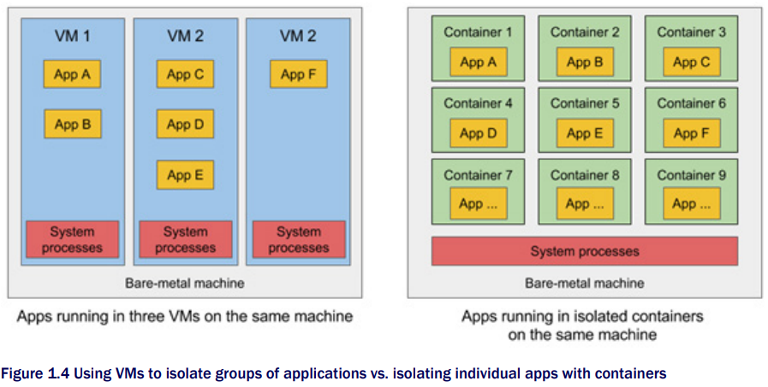

Slide 27
When you run three VMs on a host, you actually have three completely separate operating systems running on and sharing the same bare-metal hardware.
Underneath those VMs is a hypervisor, which divides the actual hardware resources into smaller sets of virtual resources that can be used by the operating system inside each VM.
Applications running inside those VMs perform system calls to the Kernel inside the VM and the Kernel then performs x86 instructions on the host’s physical CPU through the Hypervisor.

Slide 28
Containers, on the other hand, all perform system calls on the exact same Kernel and this single Kernel is the only one performing x86 instructions on the host’s CPU.
The CPU doesn’t need to do any kind of virtualization like it needs to with VMs

Slide 29
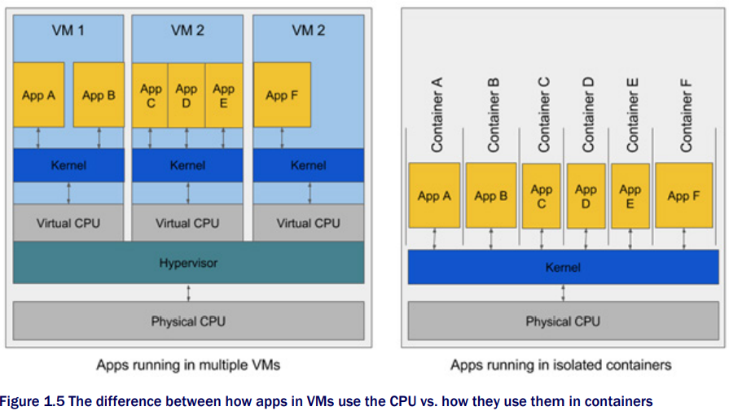

Slide 30
To run bigger numbers of isolated processes on the same machine, containers are a much better choice because of their low overhead.
Remember, each VM runs its own set of system services, while containers don’t – the host OS runs only one set of them.
Then there’s also the fact that a VM needs to boot up first, before it can run your process, while a container is just that single process, and it can start up immediately.

Slide 31
How does containers ensure isolation?
By this point, you’re probably wondering how exactly containers are able to isolate processes if they are running on the same operating system.
There are two mechanisms that make this possible.
The first one, Linux Namespaces, makes sure each process sees its own personal view of the system (files, processes, network interfaces, hostname, etc.).
The second one is Linux Control Groups (cgroups), which limit the amount of resources the process can consume (cpu, memory, network bandwith, etc.).

Slide 32
Kubernetes
We’ve already shown that as the number of deployable application components in your system grows, it starts to become hard to manage them all.
Kubernetes enables you to run your software applications on thousands of computer nodes as if all those nodes were a single, enormous computer.
It abstracts away the underlying infrastructure and, by doing so, simplifies the development lifecycle for both the developers and the system administrators.

Slide 33
Deploying applications through Kubernetes is always the same, whether your cluster contains only a couple of nodes or thousands of them.
The size of the cluster makes no difference at all.
Additional cluster nodes simply increase the amount of resources available to deployed apps

Slide 34
Core of Kubernetes
The system is composed of a master node and any number of worker nodes.
When the developer submits a list of apps to the master, Kubernetes deploys them across the cluster of worker nodes.
The developer can specify that some apps must run together and they will indeed be deployed on the same worker node.
Others will be spread around.
But, regardless of where each app is deployed, it can find other apps and communicate with them easily

Slide 35
Developers focus on the core app features
Kubernetes can be thought of as an operating system for the cluster.
It relieves application developers from having to implement certain infrastructure-related services into their apps and instead rely on Kubernetes to provide these services.
This includes things like service discovery, scaling, load-balancing, self-healing and even leader election.
Application developers can therefore focus on implementing the actual features of the applications and not waste time figuring out how to integrate them with the infrastructure.

Slide 36
Kubernetes will run your containerized app somewhere on the cluster, provide information to its components on how to find each other, and keep all of them running.
Since your application doesn’t care which node it is running on, Kubernetes can relocate the app at any time, and by doing so can achieve far better resource utilization than is possible with manually scheduled apps.

Slide 37
Architecture of Kubernetes
A Kubernetes cluster is composed many nodes, which can be split into two types
the Kubernetes Control Plane (in essence, the master node(s)), which controls and manages the whole Kubernetes system,
worker nodes, which run the actual applications you deploy

Slide 38
Control Plane
API Server, which you use to communicate with and perform operations on the Kubernetes cluster,
The Scheduler, which is responsible for scheduling your apps (assigning a worker node to each deployable component of your application),
The Controller Manager, which performs cluster-level functions, such as replicating components, keeping track of worker nodes, etc.,
etcd, a reliable distributed data store that stores the whole cluster configuration persistently.

Slide 39
Running application on Kubernetes
In order to run an application, you need to package it up into one or more Docker images, push those images to a Docker registry and then post a description of your app in the form of an app descriptor to the API server.
When the API server processes your app’s description, the scheduler will schedule the specified groups of containers onto the available worker nodes, based on resources required by each group and the available resources on each node at that moment.

Slide 40
The Kubelet on those nodes will then instruct Docker to pull the necessary Docker images and run the containers.

Slide 41
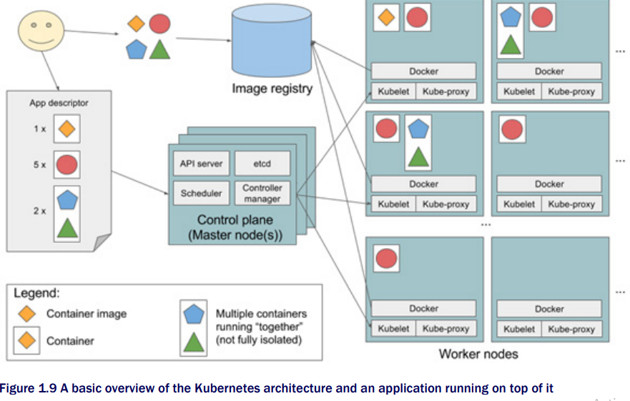

Slide 42
Once the application is running, Kubernetes will then continuously make sure that the actual state of the application always matches the description you provided.
For example, if you specify that you always want five instances of a web server running, Kubernetes will always keep exactly five instances running.
If one of those instances stops working properly, like when its process crashes or when it stops responding, Kubernetes will restart it automatically

Slide 43
Benefits of Kubernetes
Scaling
Health checking
Self healing
Simplifying application development

Slide 44
Serverless architecture
Serverless was first used to describe applications that significantly or fully incorporate third-party, cloud-hosted applications and services, to manage server-side logic and state
Serverless can also mean applications where server-side logic is still written by the application developer, but, unlike traditional architectures, it’s run in stateless compute containers that are event-triggered, ephemeral (may only last for one invocation), and fully managed by a third party.

Slide 45
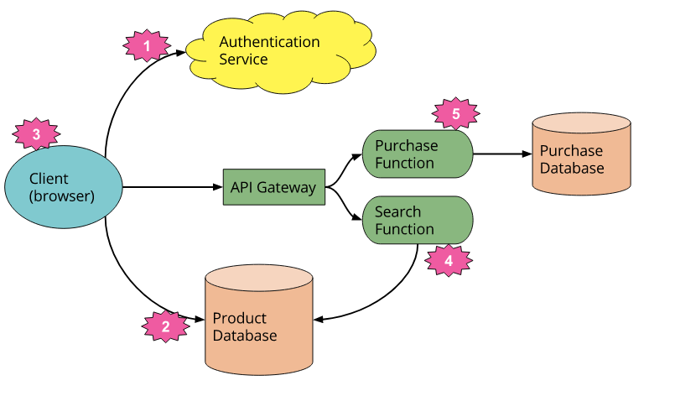

Slide 46
AWS Lambda
AWS Lambda lets you run code
without provisioning or managing servers. (1) ...
With Lambda, you can run code for virtually any type of application or backend service (2) –
all with zero administration. Just upload your code and Lambda takes care of everything required to run (3)
and scale (4)
your code with high availability. You can set up your code to automatically trigger from other AWS services (5)
or call it directly from any web or mobile app (6).

Slide 47
FaaS
FaaS is about running backend code without managing your own server systems or your own long-lived server applications.
Horizontal scaling is completely automatic, elastic, and managed by the provider.

Slide 48
FaaS functions are typically limited in how long each invocation is allowed to run. At present the “timeout” for an AWS Lambda function to respond to an event is at most five minutes, before being terminated.
It takes some time for a FaaS platform to initialize an instance of a function before each event.

Slide 49
Benefits & drawbacks
Some of the benefits are:
Reduced operational cost
BaaS: reduced development cost
FaaS: scaling costs
Inherent drawbacks
Vendor lock
Security concerns

Slide 50
Continuous Integration
Continuous integration is a DevOps software development practice where developers regularly merge their code changes into a central repository, after which automated builds and tests are run.
We know that in the DevOps practice, we have a single version control tool for both Development and Operations team, where everyone’s code will be deposited as a master code base and this allows the team to work in parallel.

Slide 51
So, Continuous Integration, in DevOps is nothing but merging individual developers code into the master copy of the code to the main branch where version control is maintained. There is no restriction on no of times for the code merge that needs to happen in a day.
As and when the developer checks in their code to the version control, immediately the process of CI kick starts.

Slide 52
Continuous integration most often refers to the build or integration stage of the software release process and entails both an automation component (e.g. a CI or build service) and a cultural component (e.g. learning to integrate frequently).
The key goals of continuous integration are to find and address bugs quicker, improve software quality, and reduce the time it takes to validate and release new software updates.

Slide 53
Continuous Integration process
Merging of all the Developers code to the main line,
Triggering a build,
Compiling the code and making a build and ….lastly
Carrying out the unit test.
So, Continuous Integration is a process of merging all the developer’s code to a central location and validating each one of their merges with an automated build and test.

Slide 54
There will be a server for continuous integration which hosts the CI tool, which keeps watching the version control tool for the code check-in and as soon as, a check-in is found, it triggers the automated compilation, builds and runs unit testing along with static code analysis and a basic level of automated security testing.
The various tools to carry out the automated testing, like Jenkins, TestNG, NUnit to carry out unit testing, Sonar to carry out static code analysis, and fortify to carry out the security testing, all of these tools will be integrated with the CI pipeline.
So, the complete CI pipeline is an automated process without any manual intervention and runs within a few seconds or minutes.

Slide 55
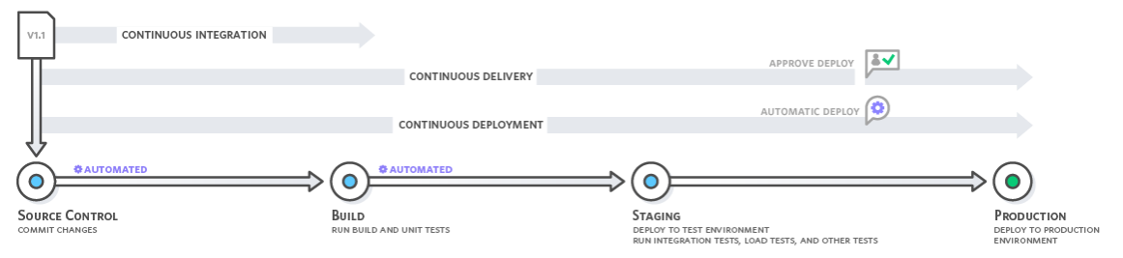

Slide 56
Why continuous integration
In the past, developers on a team might work in isolation for an extended period of time and only merge their changes to the master branch once their work was completed.
This made merging code changes difficult and time-consuming, and also resulted in bugs accumulating for a long time without correction.
These factors made it harder to deliver updates to customers quickly.

Slide 57
Continuous integration refers to the build and unit testing stages of the software release process. Every revision that is committed triggers an automated build and test.
With continuous delivery, code changes are automatically built, tested, and prepared for a release to production. Continuous delivery expands upon continuous integration by deploying all code changes to a testing environment and/or a production environment after the build stage.

Slide 58
Continuous Integration Benefits
Improve Developer Productivity: Continuous integration helps your team be more productive by freeing developers from manual tasks and encouraging behaviors that help reduce the number of errors and bugs released to customers.
Find and Address Bugs Quicker: With more frequent testing, your team can discover and address bugs earlier before they grow into larger problems later.

Slide 59
Deliver Updates Faster: Continuous integration helps your team deliver updates to their customers faster and more frequently.

